Slide 1


XYZ company
Data Analysis
Report
by Niyati Sharma
sharmaniyati1010@gmail.com | Linkedin

Slide 2

Introduction
Overview of the main objectives
This document presents five strategic analytical features that can help our EdTech platform optimize performance and achieve business objectives.
A focused Search Behaviour Analysis has been carried out to showcase the analytical approach and highlight key insights for improving user journeys.

Slide 3




About the company
Organization
Mission
XYZ is a modern online learning marketplace that connects learners with high-quality courses across technology, business, and creative fields.
To make high-quality, affordable education accessible to every learner—anytime, anywhere.
Vision
Core values
To become the most trusted learning ecosystem where personalised learning paths empower individuals to achieve their career goals.
Learner-First Approach,Innovation,Accessibility Integrity

Slide 4



5 Analytical Features
Course Recommendation Engine (Personalized Learning Path)
Instructor Performance Dashboard
Tracks course ratings, completion rate, student feedback, revenue for instructors.
A recommendation system that uses Uses user history, ratings, and categories to recommend courses.
Course Engagement Analytics
Search Behavior Analytics (Top Keywords, CTR, Zero-result search)
Video watch time, drop-off points, daily/weekly activity heatmaps.
Conversion Funnel Analytics
Analyze what students search, click and what they don’t find.
Track users from: Browse → View Course → Add to Cart → Purchase.

Slide 5



Search Behaviour Analytics
What is it?
Search Behaviour Analytics helps understand how users interact with the search function on a digital platform. By analysing what users search for, how often they search, what they click on, and whether they eventually convert, platforms can identify user intent, improve content discovery, and optimize recommendations. This analysis helps bridge the gap between user expectations and the platform’s offerings, leading to better engagement and higher conversions.

Slide 6

Need of Search Analytics
Problem Statement:
To improve course discoverability and user engagement on LearnSphere, we aim to analyse search behaviour patterns including search frequency, clicks, CTR, conversion rates, and keyword intent. This analysis will help identify high-demand topics, search-result mismatches, potential content gaps, and opportunities for personalization. Insights from this study will support smarter course recommendations and enhance overall user experience.

Slide 7
Psuedo code
BEGIN
1. LOAD search logs data:
- Search_Term
- User_ID
- Searches
- Clicks
- Enrolls
- Timestamp
2. CLEAN the data:
- Remove missing values
- Standardize keywords (lowercase, trim spaces)
- Group similar keywords using mapping table
3. CALCULATE performance metrics for each search term:
FOR each Search_Term:
CTR = Clicks / Searches
Conversion_Rate = Enrolls / Clicks
Engagement_Score = weighted sum of {CTR, Conversion_Rate, Session_Duration}
4. CLASSIFY search intent:
IF CTR > threshold_high AND Conversion_Rate > threshold_high:
Label as "High Intent Keyword"
ELSE IF CTR high AND Conversion low:
Label as "Interest but Low Purchase Intent"
ELSE IF CTR low AND Conversion high:
Label as "High Potential but Low Visibility"
ELSE:
Label as "Low Intent Keyword"
5. IDENTIFY gaps and opportunities:
- High_Search_Volume + Low_Conversion = Search-Result Mismatch
- High_Conversion + Low_Search_Volume = Promote/Boost this Topic
6. GENERATE insights:
- Top 10 keywords with highest demand
- Keywords that need more courses/content
- Keywords to be promoted
- User segments based on search frequency and conversions
7. OUTPUT results:
- Summary table of metrics
- Visualizations (heatmap, funnel, scatter, Pareto)
- Recommendation list for content teams
END

Slide 8



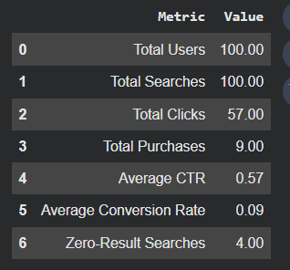
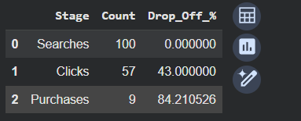
Analyses
Descriptive Summary
Funnel Report
Keyword performance report
search engagement is healthy, but conversion optimization and search-result quality still need improvement.
The funnel highlights that the highest loss occurs between clicking and purchasing, suggesting that improvements in course page experience, recommendations, or pricing strategies could directly increase conversions.
This report is in tabular format which has column names as -
search_query, search_count, results_count, clicked, CTR, purchased,Conversion, no_results
which will be further used for data analysis.
View the table

Slide 9
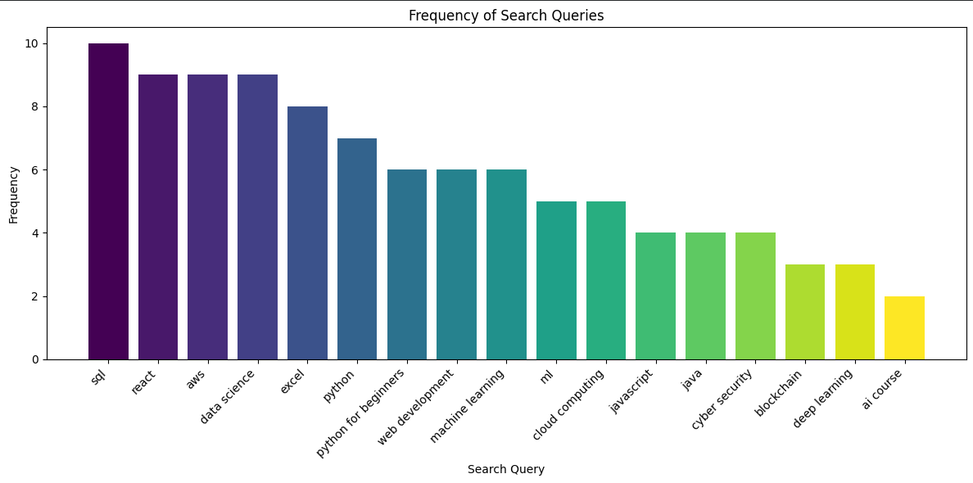
Performance Highlights

Slide 10
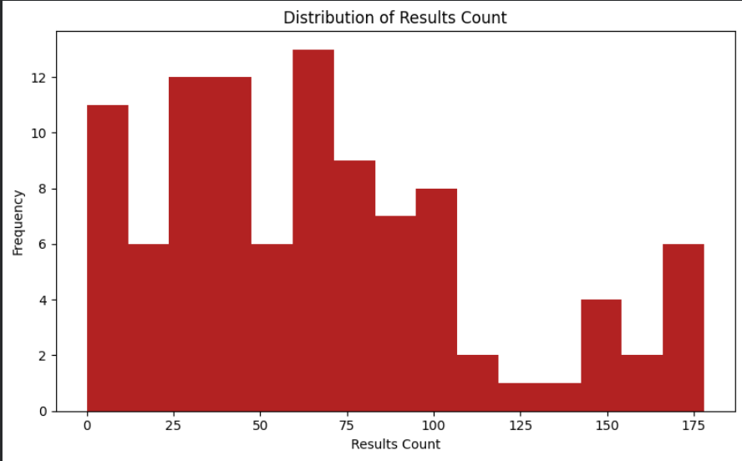
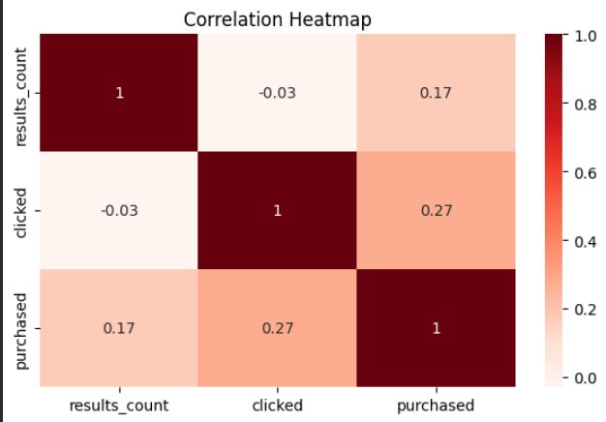
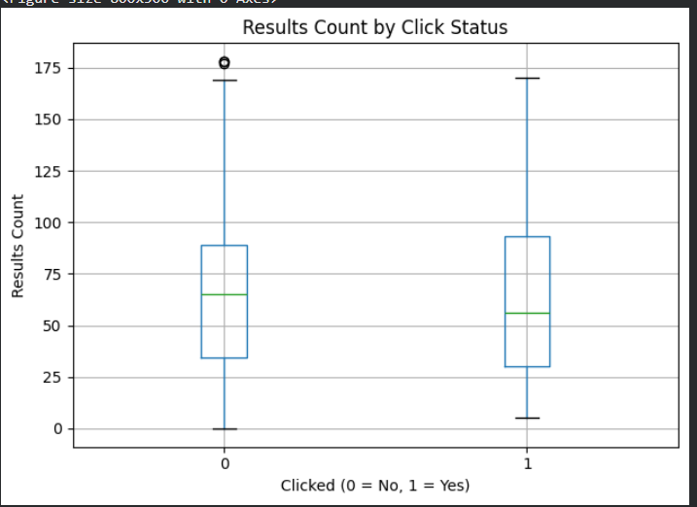
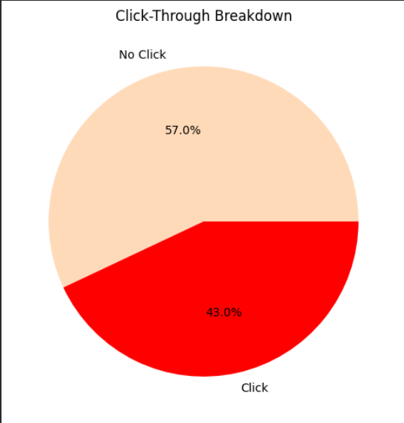
Highlights of analysis
clicks and purchases are positively correlated with the number of results
how many results users typically receive.
highlights user engagement.
Users who clicked generally received higher results counts

Slide 11

Conclusion
The search behaviour analysis reveals that users exhibit strong interest in technical and upskilling-focused topics, particularly Python, Data Science, and Machine Learning. Search results availability plays a significant role in user engagement—queries with richer results drive higher click-throughs and conversions. The correlation patterns suggest that improving the relevance and volume of search results can enhance user experience and increase the probability of course enrollments. Overall, the dataset highlights clear opportunities for optimizing search algorithms to boost engagement and support user learning pathways.

Slide 12


Future Goals and Strategies
Future goals
1. Personalized Search Recommendations
Future analysis can explore user-level browsing patterns, past purchases, and skill profiles to build personalized search ranking models that show the most relevant results first.
Trend Analysis Over Time
Monthly/quarterly comparisons of searches, clicks, and conversions can help the company identify emerging skills, peak user interest periods, and seasonal demands.
Cohort Analysis
Grouping users by segments (new users, returning users, paid users) can reveal behavioural differences and improve targeted marketing strategies.

Slide 13

XYZ company
Thank
You

